Slide 1
UBER FARES DATASET ANALYSIS USING POWER BI
Course: INSY 8413 – Introduction to Big Data Analytics
Lecture: Prof. Eric Maniraguha
Std Name & ID: Rukundo Espoir 27678
Date: 25th July 2025

Slide 2
Project Overview
Goal: analyze Uber fare data to uncover trends, patterns, and insights
Tools: Python (Jupyter), Power BI
Deliverables: Interactive dashboard (.pbix), report (this deck), cleaned CSV, GitHub repo, screenshots

Slide 3
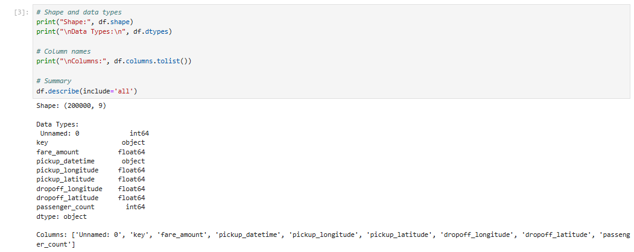
Dataset Description
Source: Uber Fares Dataset from Kaggle
Variables: fare amount, pickup datetime, pickup longitude/latitude, drop off longitude/latitude, passenger count, etc.

Slide 4
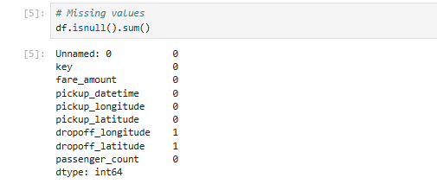
Data Cleaning Methodology
Checked for missing values
Dropped null entries
Converted data types (e.g., datetime)
Removed outliers

Slide 5
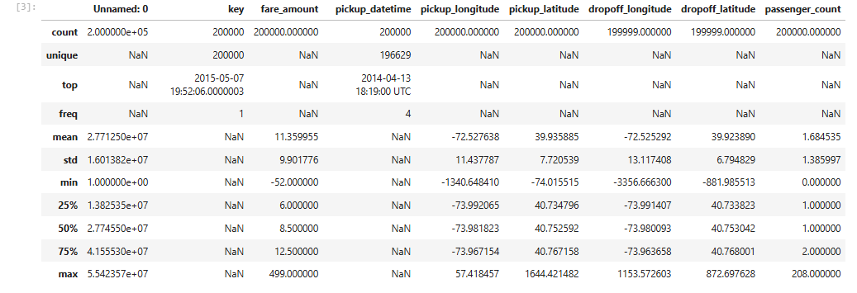
Exploratory Data Analysis (EDA)
Checked structure, data types, unique values, missingness.
Summary statistics (mean, median, std, IQR) for fare_amount & distance.
Identified outliers & invalid coords.

Slide 6
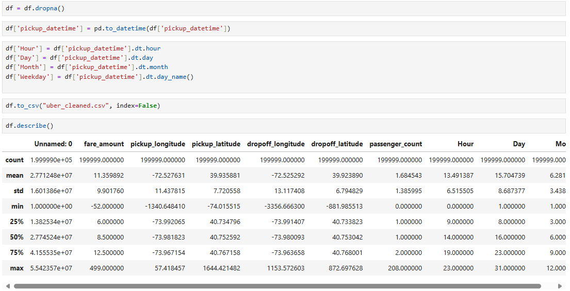
Feature Engineering
Created features:
hour, day, month, weekday extracted from pickup_datetime
Saved enhanced CSV for Power BI import.

Slide 7
Export to CSV
Final cleaned & engineered dataframe exported
to: uber_features.csv

Slide 8
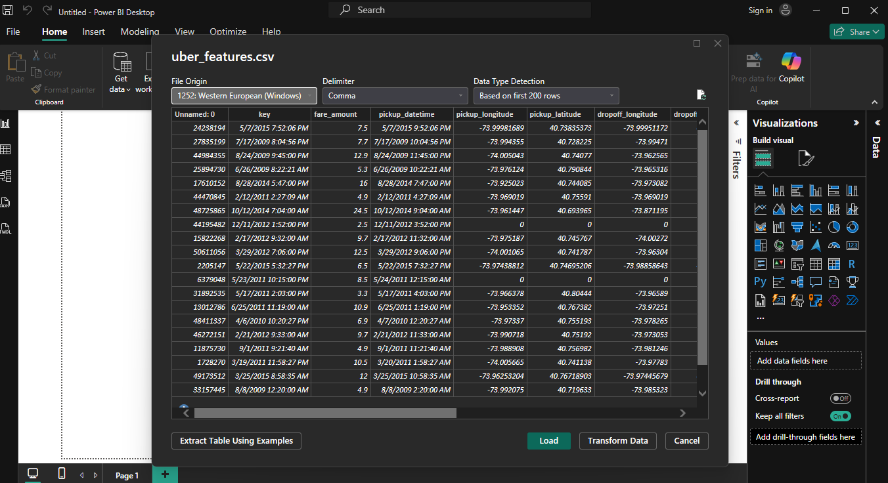
Power BI – Data Import
Imported the cleaned CSV into Power BI

Slide 9
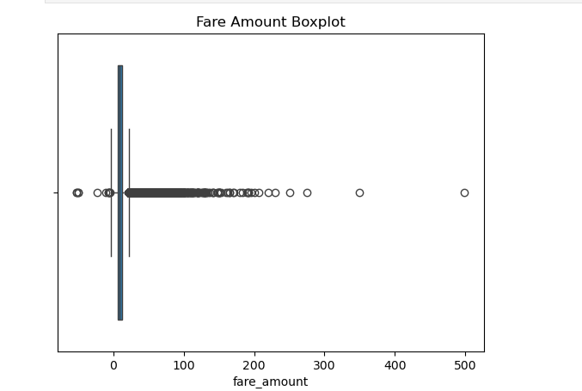
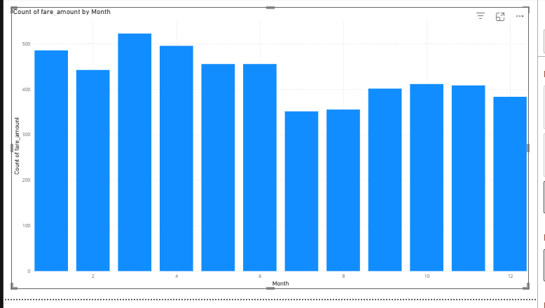
Fare Distribution
Histogram of Fare Amounts
Boxplot to detect outliers

Slide 10
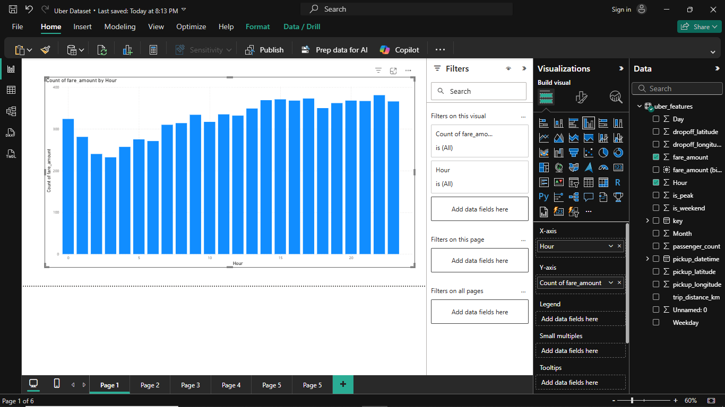
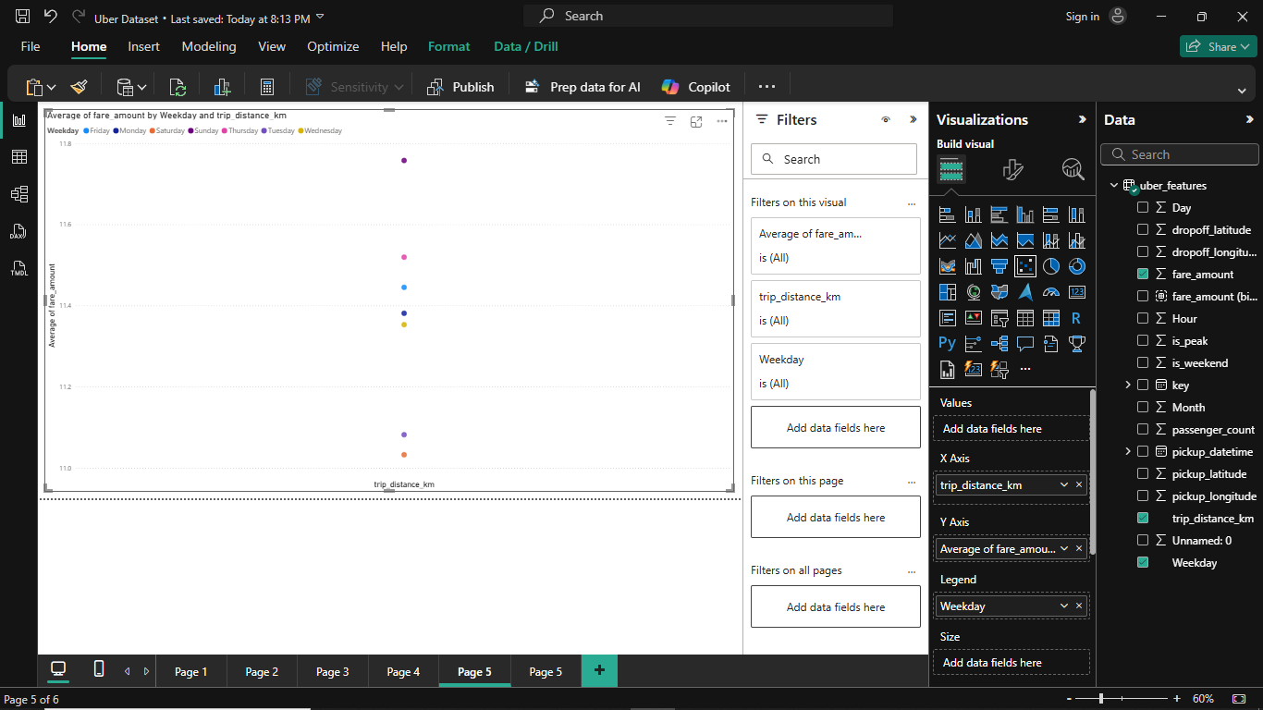
Time-based Trends
Fare vs. Distance
Fare vs. hour

Slide 11
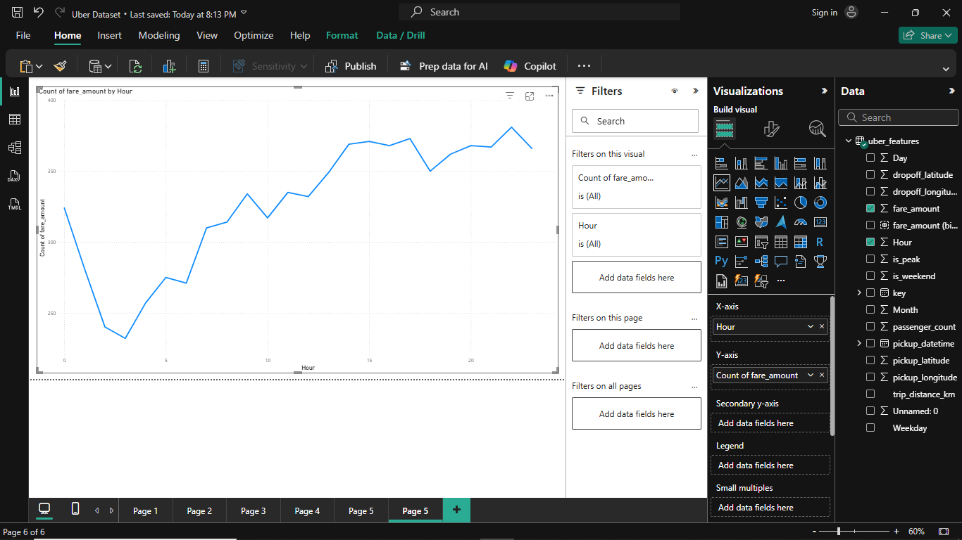

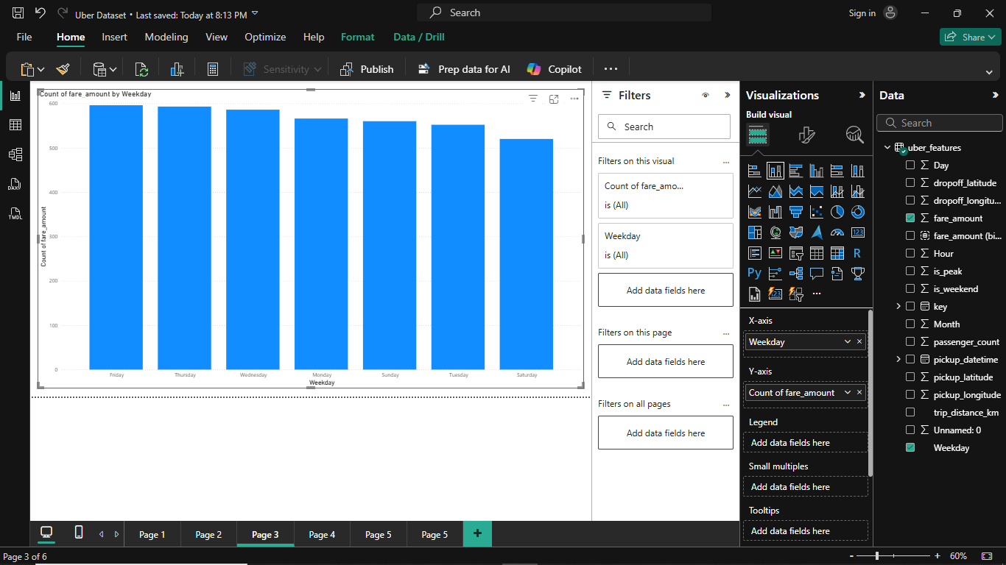
Time-based Trends (continued)
• Average fare by hour (line chart)
• Fare by month/weekday

Slide 12
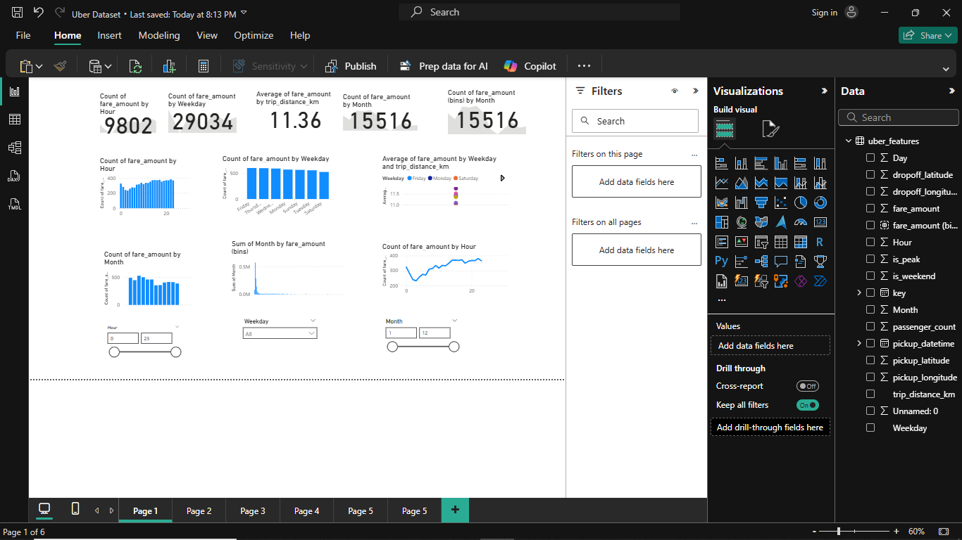
Dashboard Design & Interactivity
Design principles applied:
• Clear layout: KPI on top, trends & distribution center, filters bottom
• Slicers: month, weekday, hour
• Consistent formatting (Theme, colors, fonts)

Slide 13
Key Insights
Peak Demand: Rides peak during morning (7-9 AM) and evening (5-7 PM) commuting hours.
Weekday Focus: Ride frequency is highest mid-week (Tuesday-Thursday),
dropping noticeably on Fridays and weekends.
Seasonal Decline: Rides and total fare amounts significantly decline in later months
(e.g., November-December), with higher activity earlier in the year.
Average Fare: The average fare per trip distance is approximately $11.36.
Total Rides: The dataset contains 9,802 unique fare amounts/rides.

Slide 14
Conclusion
The Power BI dashboard provides a clear view of fare distribution, time-based trends, and fare-distance relationships. These insights can support better decision-making for pricing strategies and operations. Further improvements can be achieved by integrating external factors like weather and event data.

Slide 15
Recommendations
Optimize Peak Supply: Incentivize drivers during morning (7-9 AM) and evening (5-7 PM) peaks to
maximize availability, reduce wait times, and capture more rides.
Boost Off-Peak/Weekend Demand: Offer targeted promotions for off-peak hours and weekends; explore partnerships
for specials. This stimulates demand during slower periods, improving driver utilization and ride volume.
Mitigate Seasonal Decline: Develop specific year-end marketing campaigns or offerings (e.g., holiday travel,
shopping promotions, airport transfers) to proactively create demand and mitigate revenue drops in months 11-12.
Refine Pricing: Analyze weekday/distance fare variations to identify optimal pricing. Consider dynamic models
adapting to real-time supply/demand to ensure competitive, optimal revenue.
Improve Dashboard Clarity: Clarify top-level metric definitions and aggregation methods
(e.g., "Count of fare_amount") for consistency and better interpretability, preventing misinterpretations.
Segment Customers: If feasible, segment users (e.g., commuters, leisure, business) to analyze distinct ride patterns.
This informs tailored marketing and service development, enabling precise targeting.

